Slide 1
MEDB 5510 Clinical Research Methods
Week 8
Measurement & Descriptive Statistics

Slide 2
Measurement
What do we mean “measurement”?
assignment of numbers or symbols to the different levels or values of variables according to rules.”

Slide 3
Measurement
Assigning a number to represent …
Continuous value
Discrete value
Precision of measurement
Continuous variable …
Discrete variable …

Slide 4
Measurement
What is the measurement representing?
Actual measurement …
Length, time, …
Indirect measurement
Constructs
Whatever you are trying to measure ..
Must be able to define it!

Slide 5
Measurement
Traditional levels (scales) of measurement
Nominal
Ordinal
Interval
Ratio

Slide 6
Measurement
Authors categorization of levels of measurement
Nominal
Dichotomous
Ordinal
Normally distributed
Table 10.1

Slide 7
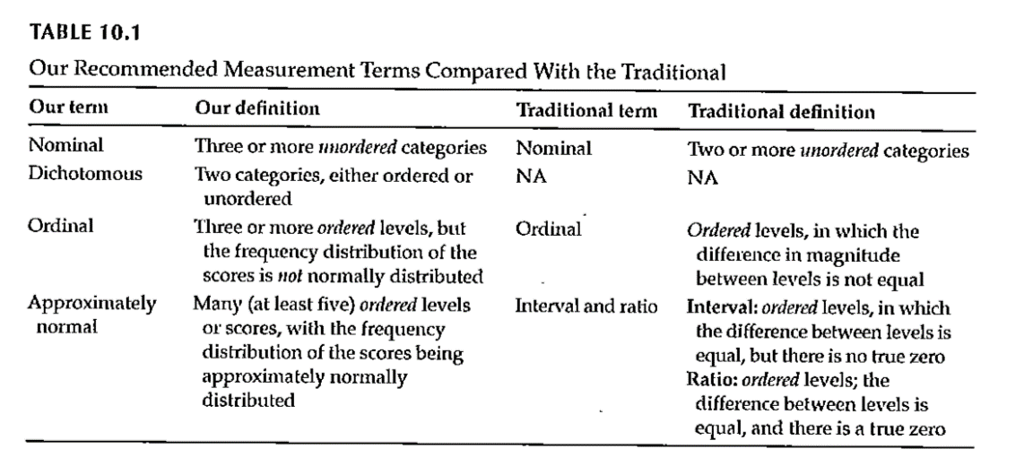
Measurement

Slide 8
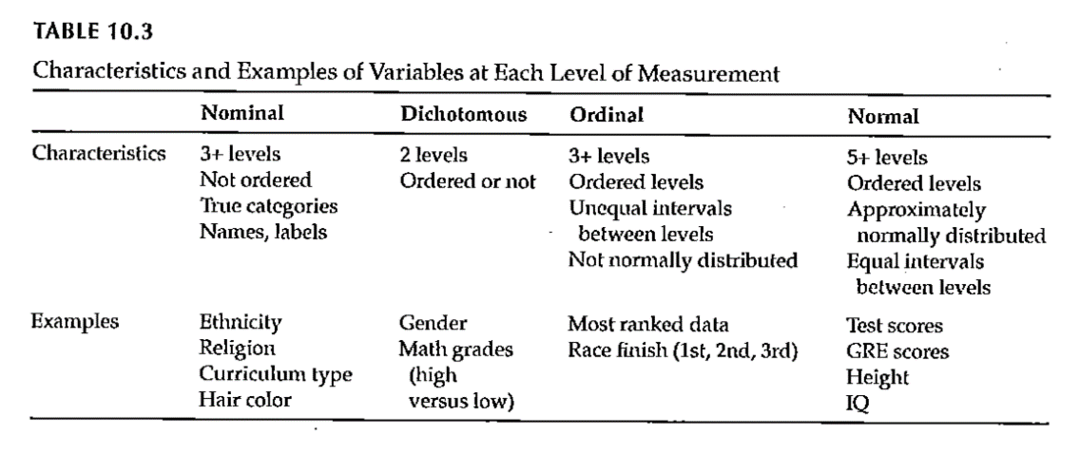
Measurement

Slide 9
Measurement
Why does the scale of measurement matter?
How it reflects your design and your research question
How it determines the types of statistical analyses you will do
How it defines what you can say about your results

Slide 10
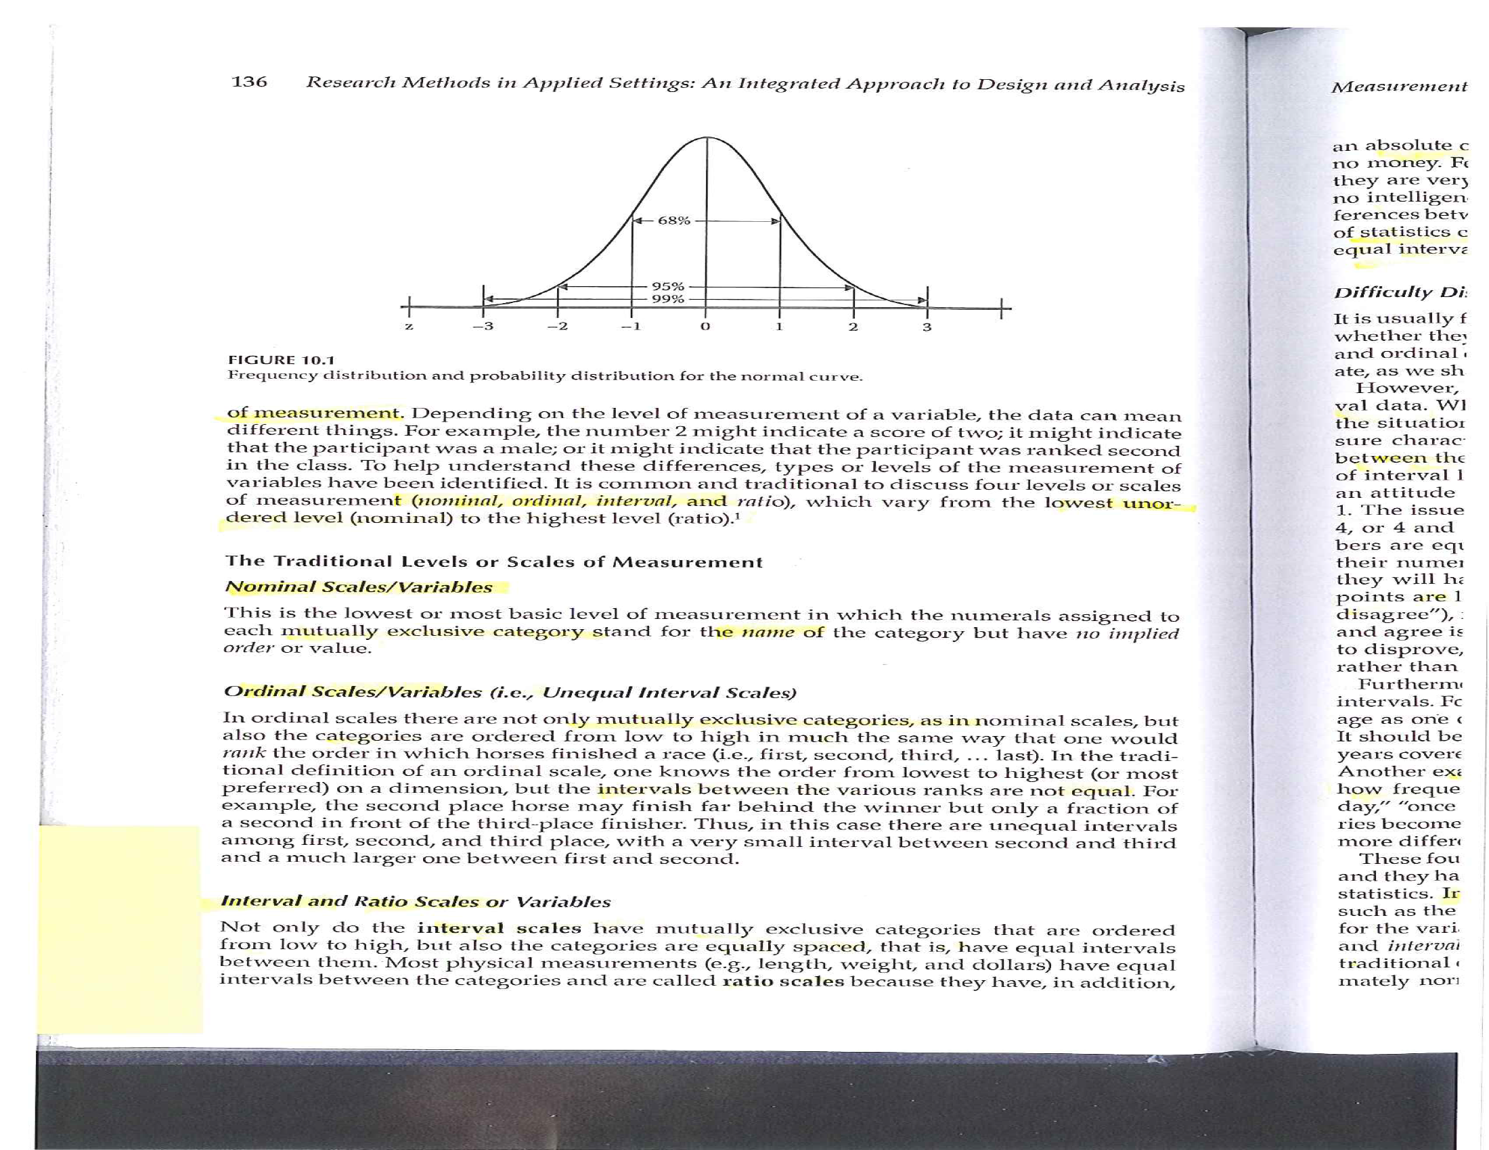
Descriptive Statistics

Slide 11
Descriptive Statistics
Descriptive graphs
How to look at your data
Options for viewing your data
Frequency polygons
Histograms
Bar charts

Slide 12
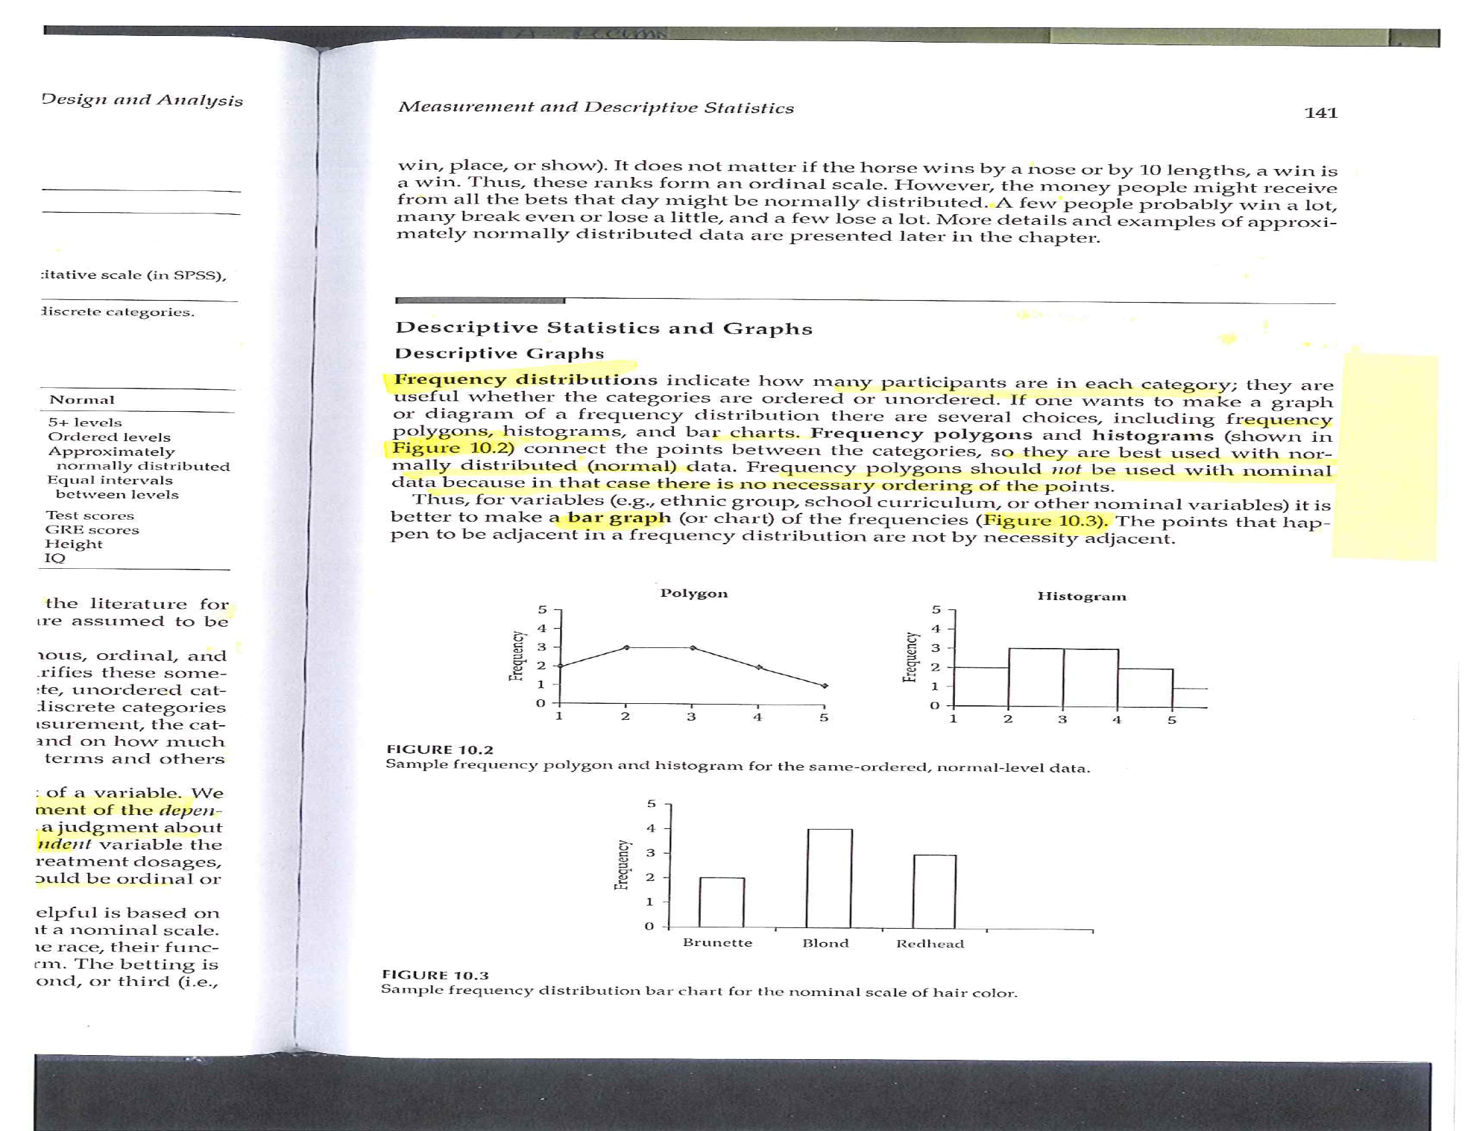
Descriptive Statistics

Slide 13
Descriptive Statistics
Measures of central tendency
Mean
Median
Mode

Slide 14
Descriptive Statistics
Measures of variability
Range
Standard deviation
Interquartile range
How many categories

Slide 15
Descriptive Statistics
Measures of association between 2 variables
Correlation
Pearson
Spearman
Cross-tabulation
Scatterplot

Slide 16
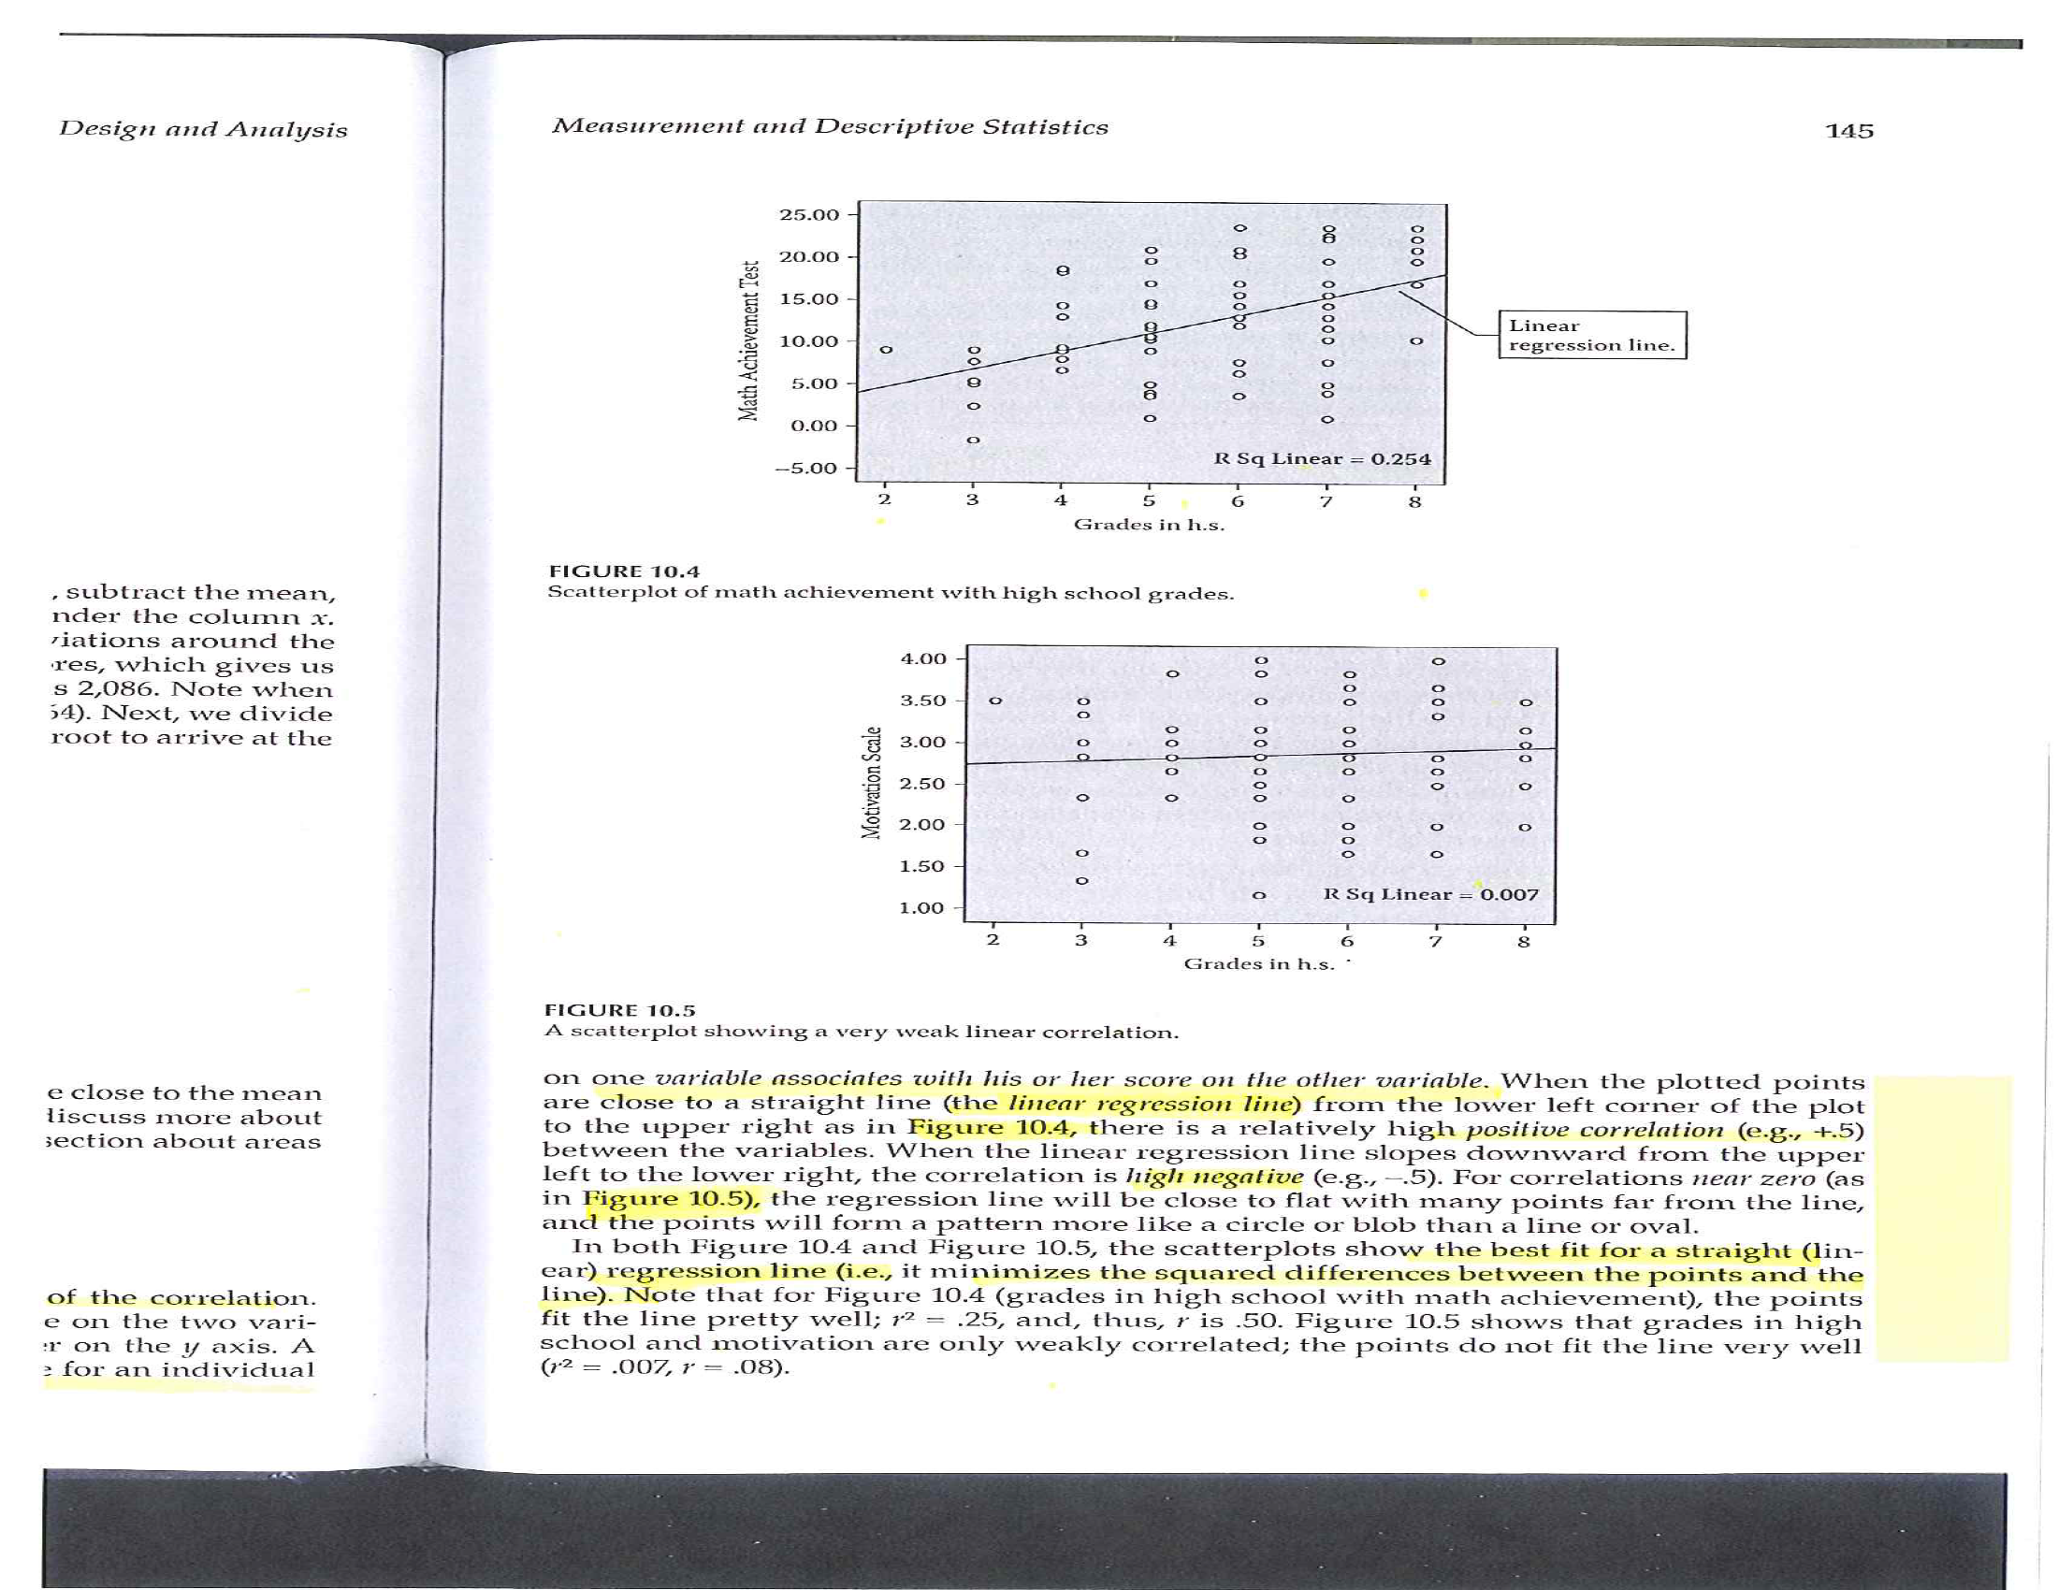
Descriptive Statistics

Slide 17
Descriptive Statistics

Slide 18
Descriptive Statistics

Slide 19
Descriptive Statistics
Properties of the normal curve
Unimodal
Mean, median, and mode are equal
Symmetric curve (skew)
Range is infinite
Shape – not too peaked or flat (kurtosis)

Slide 20
Descriptive Statistics

Slide 21
Descriptive Statistics
Standard normal curve
Definition
How to compute
Effect size

Slide 22
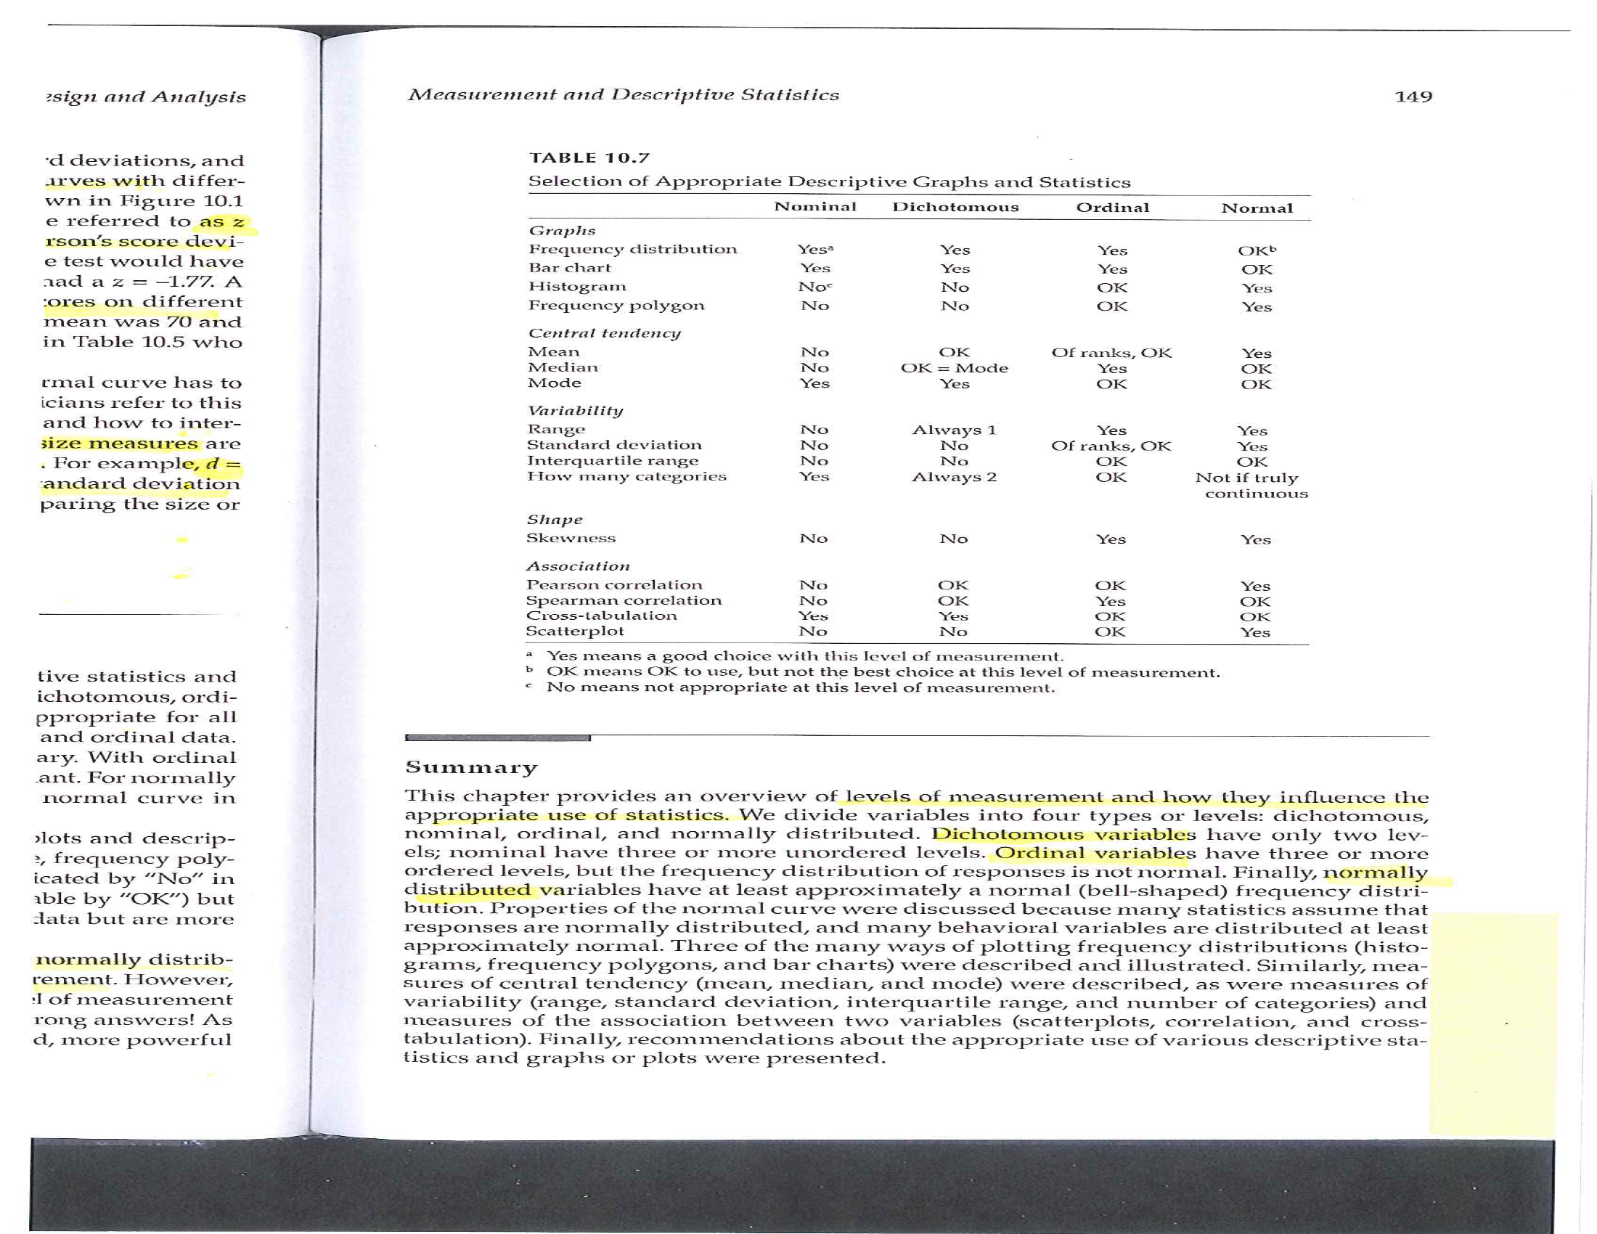
Measurement & Descriptive Statistics

Slide 23
Assignment #6
Prepare a brief paragraph that describes the research design you are using for your research proposal. This is the information that will probably appear in the Methods section of your proposal.

